Slide 1
Good to Great
Focus on skills NOT duties

Slide 2
Customer Service Rep (Atelka)
Complete required training
Answer incoming calls
Provide customer service
Handle upset/angry customers
Resolve customer account issues
Document interaction with customer
Communication skills
Customer service
Problem solving
Patience
Product knowledge
Attention to detail
Confidentiality
Computer skills
Teamwork
Company police/quality standards
DUTIES
SKILLS

Slide 3
Work Experience
Utilize effective communication skills to provide above average customer service to new and existing customers
Address customer service inquires in a timely and professional fashion
Provide accurate and appropriate information in response to customer inquires
Made rational procedure exceptions to accommodate unusual customer requests to ensure customer satisfaction, following company policy
Consistently achieved customer satisfaction rating of 95% six consecutive months, exceeding corporate targets
Actively participated in team meetings and engaged in corporate social/team building events

Slide 4
Good to Great…
It’s not just what you know…it’s what you have done with what you know!

Slide 5
Accomplishment Statements
https://lambton.optimalresume.com/
Accomplishment statements
Trained new employees
Trained new employees resulting in increased customer satisfaction
Trained more than 15 new employees over a 12 month period
Increased customer satisfaction by 25% through effectively training 15+ new employees over 1 year

Slide 6
Cover Letters

Slide 7
Purpose: To entice them to look at your resume
Introduce yourself and state your object
Sell yourself, highlighting how you meet the requirements
Keep it employer focused
Create a NEW cover letter for each job posting!!!

Slide 8
Does it answer this question:
“WHY SHOULD I HIRE YOU?”

Slide 9
CHARACTERISTICS OF A GOOD COVER LETTER
Makes a good first impression
Original and specific to each job application situation
Direct and to the point
1 page or less
Paper, Font & Style match your resume

Slide 10
COMMON PITFALLS
Overuse of “I” statements
Don’t focus on what you want
Failure to market yourself according to the job requirements
Lack of technical skills that relate to the job requirements
Improper spelling/sentence/paragraph structure

Slide 11
COVER LETTER STRUCTURE
Your Address
Date
Contact Name & Company Address
Salutation
Paragraph Structure
Closing
Enclosure

Slide 12
MARKETING YOURSELF
Focus on the employers JOB REQUIREMENTS
Refer to the job posting
Demonstrate how YOUR education, experience & skills make you a
QUALIFIED CANDIDATE
for the job
http://chk.tbe.taleo.net/chk01/ats/careers/requisition.jsp?org=SANDVINE&cws=1&rid=1346&source=Indeed.com

Slide 13
INTRODUCTION (1ST Paragraph)
This is the purpose of your letter.
What position are you applying for?
How did you find out about the opening?
Example:
“Please consider my application for the position of____________ advertised at ___________on September 15, 2011.”

Slide 14
EDUCATION (2nd paragraph)
Discuss what have you gained from your post secondary education that qualifies you for the position.
“Currently I am enrolled in the Internet Programming and Database Management post graduate program at Lambton College through which I have gained a solid working knowledge of the various programming languages”…

Slide 15
BE SPECIFIC!
Provide specific details and examples of your qualifications, training and experience
Include skills you are currently learning in your program
Include specific employment information and skills/accomplishments

Slide 16
EXPERIENCE & SKILLS (3rd paragraph)
What specific experience and skills have you gained from work, volunteering, recreational activities etc. that qualify you for the position?
“ While working as a Customer Service Representative at Atelka, I developed excellent interpersonal skills and was able to manage customers’ problems and offer effective solutions”…

Slide 17
CLOSING - (4TH Paragraph)
Thank the reader, request an interview and include contact information.
“Thank you for reviewing my resume. I look forward to further discussion of my qualifications at an interview. I can be reached at 519 555 2222.”

Slide 18
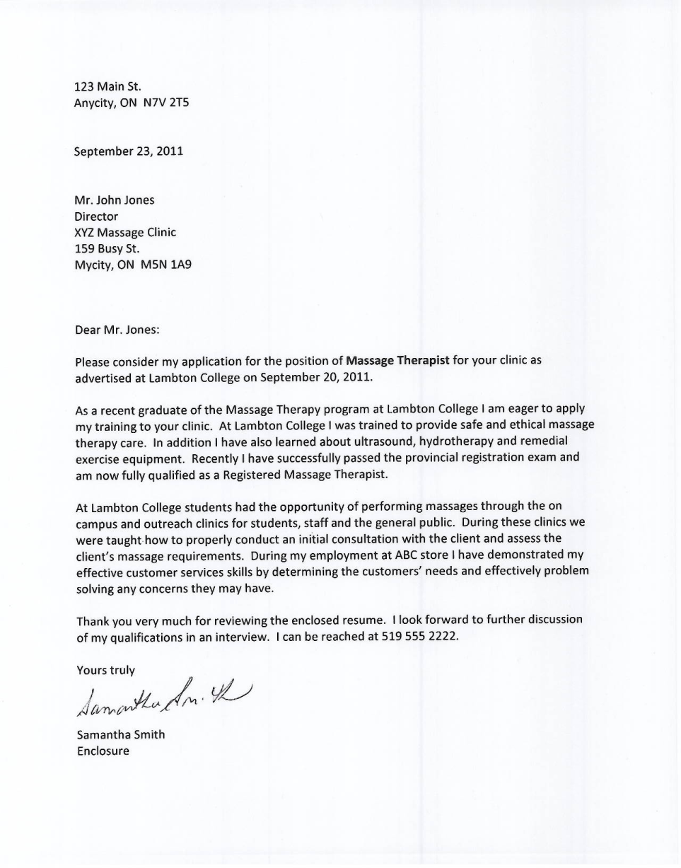
Notes:
- Hand out cover letter and resume guideline/assignment outline sheets

Slide 19
Week #6 – Online Work
The Benefit of Volunteering
http://idealistcareers.org/5-ways-volunteering-can-help-job-career/
Outline your own personal volunteer experiences, reasons why you do volunteer or reasons why you don’t
Networking
Read Article - https://www.livecareer.com/quintessential/networking-dos-donts
Identify 3 different potential network opportunities

